Slide 1

Judges
Teacher: Drew Robison
Adapted from the works of Dan Jenkins of Palm Beach Lakes Church of Christ

Slide 2
Failure To Keep God’s Commandments Bring Continual Trouble Into Our Lives
“31b For I will deliver the inhabitants of the land into your hand, and you shall drive them out before you. 32 You shall make no covenant with them, nor with their gods. 33 They shall not dwell in your land, lest they make you sin against Me. For if you serve their gods, it will surely be a snare to you.”
(Exodus 23:31-33)

Slide 3
Failure To Keep God’s Commandments Bring Continual Trouble Into Our Lives
v3 “You shall have no other gods before Me.
4 “You shall not make for yourself a carved image—any likeness of anything that is in heaven above, or that is in the earth beneath, or that is in the water under the earth; 5 you shall not bow down to them nor serve them. For I, the Lord your God, am a jealous God, visiting the iniquity of the fathers upon the children to the third and fourth generations of those who hate Me, 6 but showing mercy to thousands, to those who love Me and keep My commandments..”
(Exodus 20:3-6; Colossians 3:5)

Slide 4
Failure To Keep God’s Commandments Bring Continual Trouble Into Our Lives
v3 “Do not say in your heart, after the LORD your God has thrust them out before you, ‘It is because of my righteousness that the LORD has brought me in to possess this land,’ whereas it is because of the wickedness of these nations that the LORD is driving them out before you. 5 Not because of your righteousness or the uprightness of your heart are you going in to possess their land, but because of the wickedness of these nations the LORD your God is driving them out from before you, and that he may confirm word that the LORD swore to your fathers, to Abraham, to Isaac, and to Jacob. 6 Know, therefore, that the LORD your God is not giving you this good land to possess because of your righteousness, for you are a stubborn people.” (Deuteronomy 9:4-6)

Slide 5
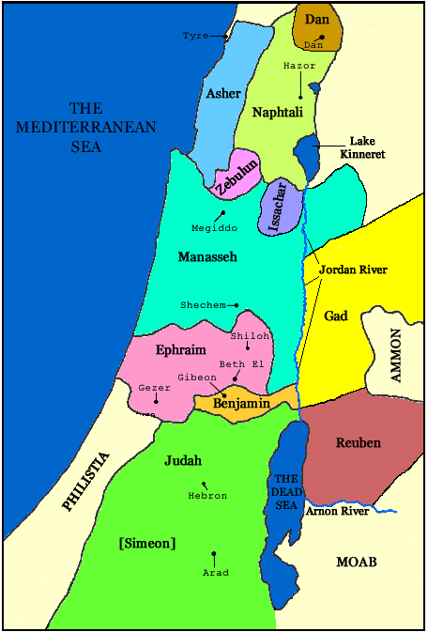
Judges — Chapter 1
1-19: Judah, Simeon, (Caleb was not a
tribe but given land due to his courage)
v21-26: Benjamin
v27-28: Manasseh
v29: Ephraim
v30: Zebulun
v31-32: Asher
33: Naphtali
34-36: Dan

Slide 6
List of the Judges
Othniel
Ehud
Shamgar
Deborah
Gideon, Abimelech
Tola, Jair, Jephthah
Ibzan, Elon, Abdon
Samson, Eli, Samuel

Slide 7
Judges
Teacher: Drew Robison
Adapted from the works of Dan Jenkins of Palm Beach Lakes Church of Christ

Slide 9
Judges
Teacher: Drew Robison
Adapted from the works of Dan Jenkins of Palm Beach Lakes Church of Christ

Slide 10
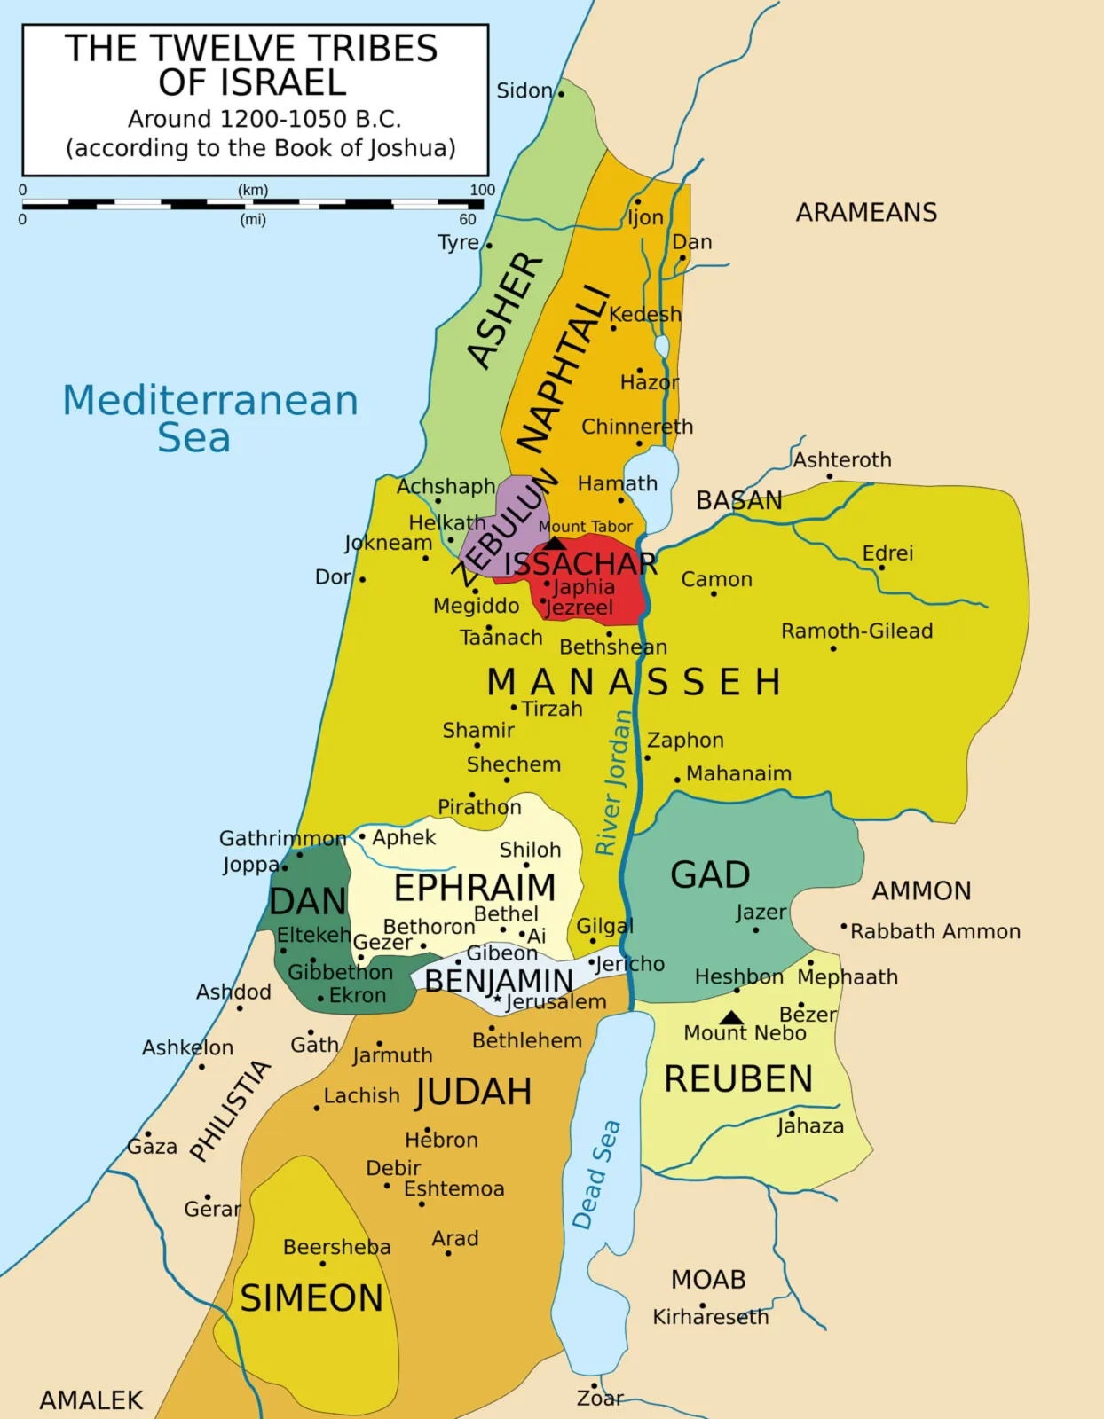

Slide 11
Judges
Teacher: Drew Robison
Adapted from the works of Dan Jenkins of Palm Beach Lakes Church of Christ

Slide 12
Faithful
Idolatry
Repentance
Deliverer/
Judge
“The Merry Go Round”
of the Judges
(The Vicious Cycle)

